Slide 1






Mastering interfaces between
Humans
#
#
Systems
#
Connected things
Industry 4.0
#
PcVue Solutions at the heart of the transformation

Slide 2





The digital revolution
Connectivity
Mobility
Interfaces
Cybersecurity

Slide 3
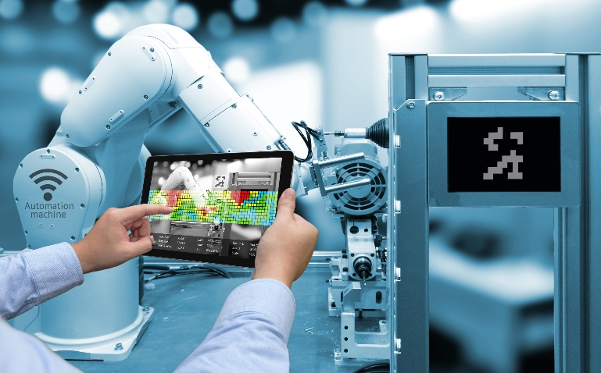
The digital revolution
The industry digitized

Slide 4
The digital revolution
New technologies based on networks
New usages
Technology complexity vs user experience
Products vs services
New production requirements
Speed, quality, adaptation
Increase of data available
Digital revolution = digitize + interconnection

Slide 5
The technologies of transformation
Internet of things – IoT/IIoT
Big Data
Cloud
Contextual mobility
Predictive analysis
- …
Notes:
Big data. This term refers to the ability to collect, store and process in real time very large flows of data of various kinds in order to apply to them all kinds of advanced analytical and statistical treatments that fall under artificial intelligence (predictive analysis, machine learning, deep learning, etc.). These powerful treatments aim to reveal information that is difficult to detect by traditional channels and that can create value. They allow continuous and real-time analysis of the environment. The big data combined with the IoT makes it possible to control the plant by the data.
Internet of things (IoT). The Internet of Things is the extension of the Internet to the physical world. The need to connect logistic and industrial objects appeared in the 2000s and developed with machine-to-machine connections. More open and benefiting from a broader purpose, the Internet has taken precedence. Today, just about everything connects to it: from the toothbrush to the car, to the smartphones. For the industrialist, IoT has a double interest: it opens up new opportunities for value creation through the connection of its products; it allows him to optimize and make flexible his production by the connection of his factory.
Mobilité. Behind this term, we mean all solutions and devices - smartphones, tablets, wearable computing, mobile applications, etc. - which allow to remain connected and to have permanent access to its working environment, in situation of mobility. The operator of the factory of the future will be mobile. n Augmented reality. Augmented reality is the superposition of digital information on an actual image viewed through a screen, glasses or viewfinder. In an industrial environment, augmented reality can be used to guide the operator to perform certain tasks or certain actions. n Virtual reality. Virtual Reality is a computer-created simulated environment in which the user is immersed and with whom they can interact. It finds its place today in the design phases to facilitate communication around a digital prototype, for example.
Cloud computing: .This is the now established model of industrialization and commercialization of computing. In the cloud, the provider provides the company with computing resources (eg applications) as a service. The user company no longer needs to buy the eventual hardware and software license. It also frees itself from the maintenance of the whole. It pays only the service consumed. Its capital investment expenditures (Capex) are transformed into operational expenses (Opex), more easily controllable. The applications offered in the cloud are called Software as a Service (SaaS) applications.

Slide 6
Opportunities
Productivity improvment
- Reducing time to market of new products
- Adapting the production to new requests
- Modernizing production tools
Human benefits
- Reduced hardness
- Increase of the interest for industry jobs
+28,5 %
Average annual turnover (2013/2014) of companies that have used IoT.
BI Intelligence, 2014*
*Comment l’Internet des objets va révolutionner la fabrication industrielle, Objetconnecte.com, mars 2016
http://www.objetconnecte.com/fabrication-industrielle-iot-etude-revolution-1403/

Slide 7
Challenges
How to integrate the new technologies to an existing system ?
How to ensure the interoperability of all the systems ?
How to manage the massive amount of data generated ?
How to increase the operationnal efficiency?
?
?
!
!
?
?
!
!
!
?
?
?
!
?
!

Slide 8
The steps for transformation
1/ Digitize
2/ Connect the remained un-connected devices
3/ Interconnect all the systems
4/ Secure the architecture
5/ Gather et aggregate the data, convert it into relevant information
6/ Monitor, control and analyse the process

Slide 9
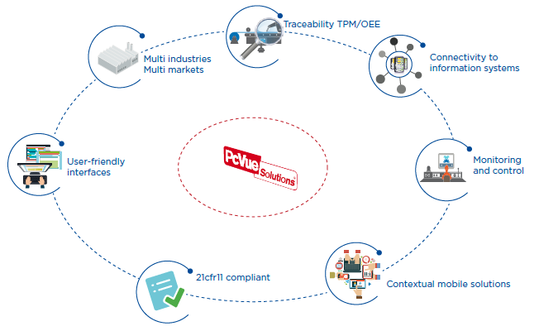
PcVue Solutions: the production platform
Notes:
To meet the constraints of modern industries, PcVueSolutions, a
suite of softwares independent from constructors and providers,
brings more than 30 years of experience and innovation for
industry market.
The needs :
Monitoring and control for any kind of industrial installations for the production or the facilities
Connecting heterogeneous devices and standardizing operation modes
Securely ensuring the continuity of the production
Optimizing the operations and maintenance of the production tools
Ensuring the traceability of production data
Reducing cost of system updates (development, operator training)
Benefit from sustainable solutions which can be autonomously managed by final users
With a rich HMI, connectivity to any kind of devices, full reporting
capabilities, and innovative tools for maintenance PcVueSolutions offers
a unique platform for industries.
Our Solutions :
Built-in support of the standard drivers of automation and control devices
Optimized management of alarms, trends and events for the operation and the maintenance
Ergonomic and user-friendly graphical interface, adaptable to all types of processes
Single development platform including an intuitive configuration environment
Interoperability ensured with the global system of your company : ERP, CMMS, quality, IT
Flexibility and scalability : from a single station to client-server architecture
Built-in support of the 21cfr11 standard
Contextual mobility solutions to facilitate the work of the operator

Slide 10
Connectivity
Connect [any] Things.

Slide 11

Data acquisition
Connectivity
Connected Platform
Wide built-in drivers 200+
OPC
Modbus IP, S7IP,…
SNMP
LoRa
SIEMENS, SCHNEIDER, Rockwell ABB,…
Advanced built-in features
Redundancy
Time stamped
…
Full interoperability
Software development kits
WebServices
OPC
A single data acquisition platform
High performances and reliability
Easy configuration

Slide 12


IoT
Connectivity
PcVue connects Things
An additional way to connect
IoT driver for LoRa
Easy to deploy architectures : wireless & self powered sensors
Objects seamlessly connected to PcVue
Support for hybrid solutions with legacy devices and new objects
Take advantage of the PcVue data treatment for your IoT

Slide 13
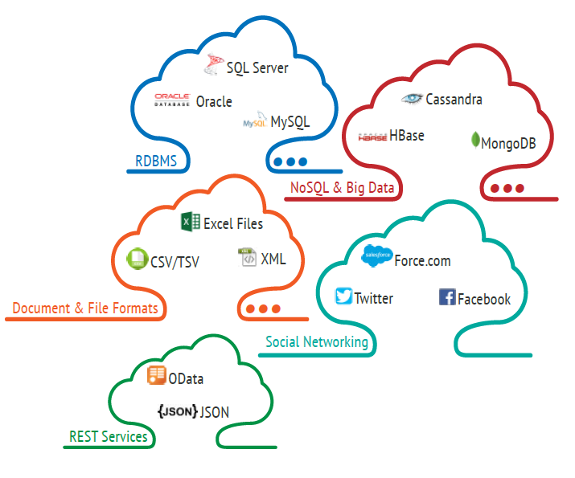
Universal Data Connector
Connectivity
Request handler for 3rd party on-premise/cloud-based RDBMS
Link to ERP,MES,CMMS, Facility
Management
Communication to Social
Networks
Connexion to REST Services

Slide 14
Cloud/Big Data
Archived data

Slide 15
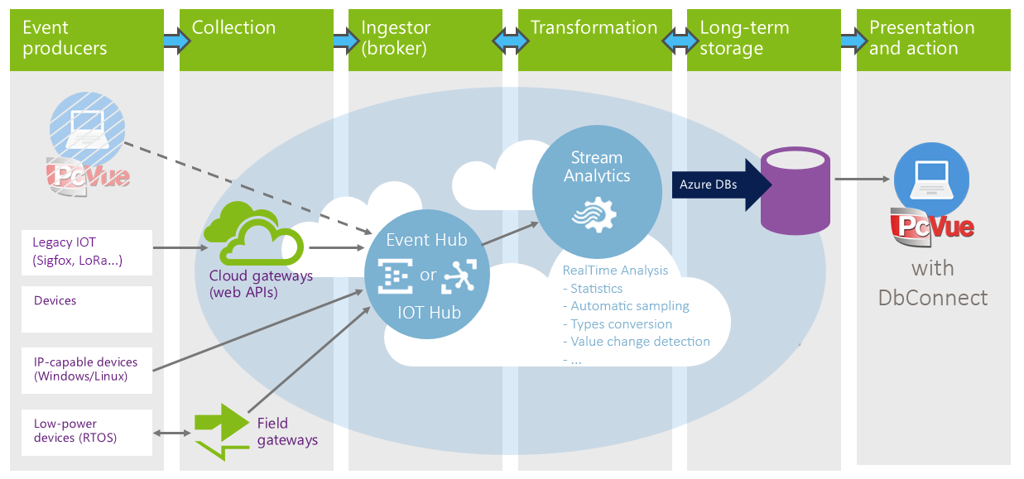
Azur connector
Connectivity
Universal data connector

Slide 16
Cybersecurity of industrial systems
Identify. Protect. Detect. React.

Slide 17
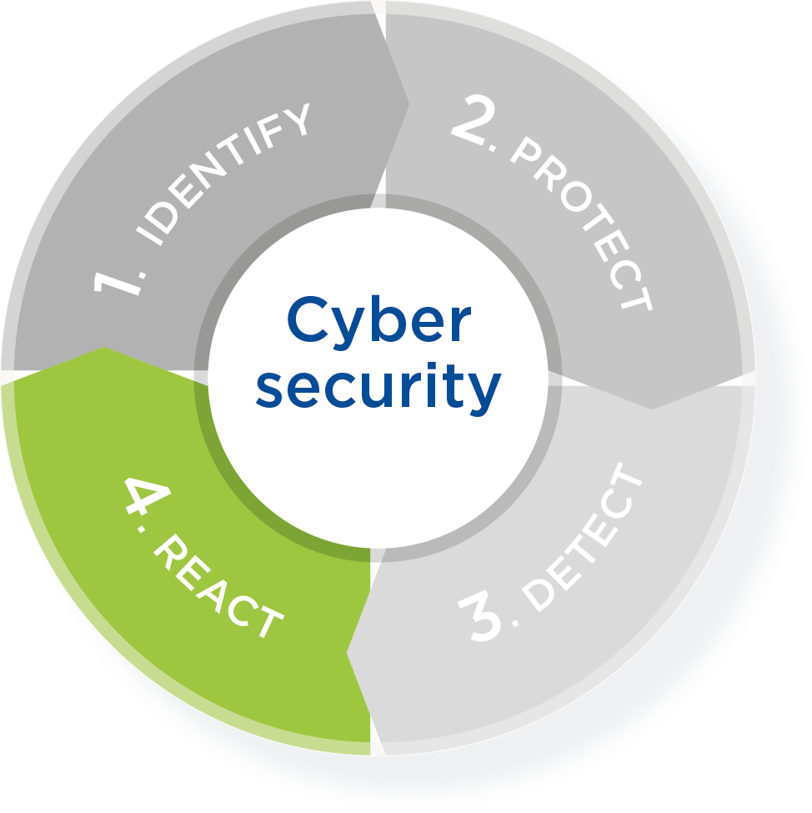
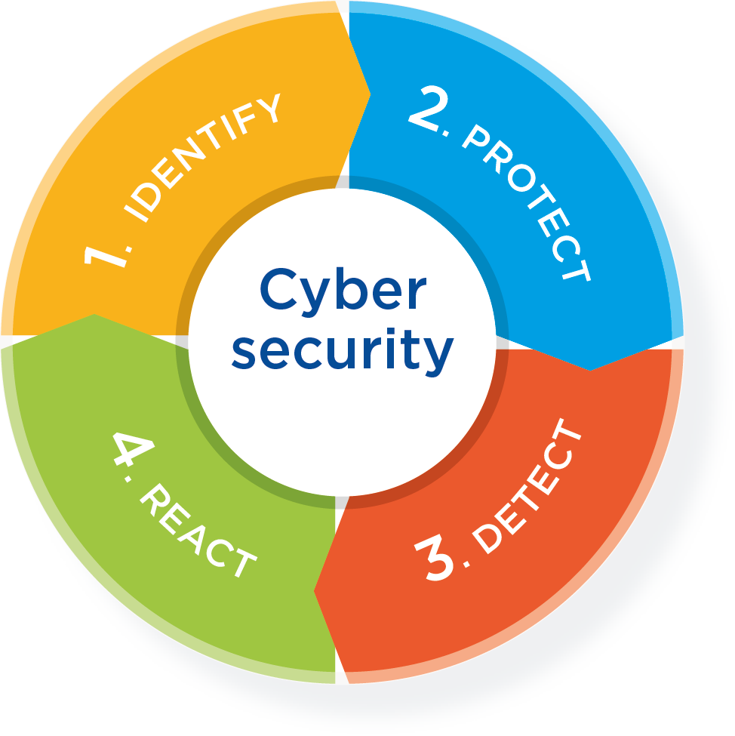
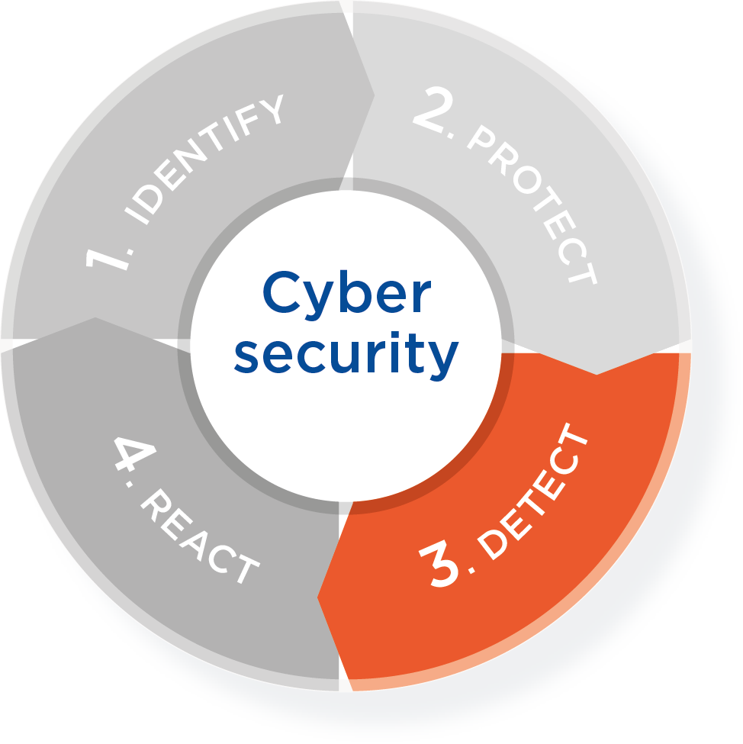
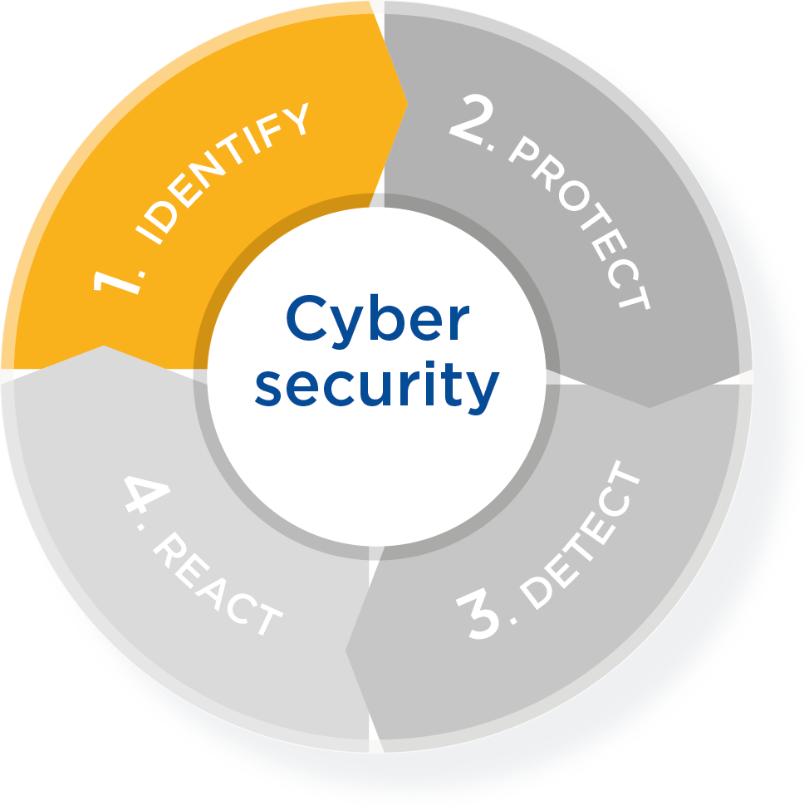
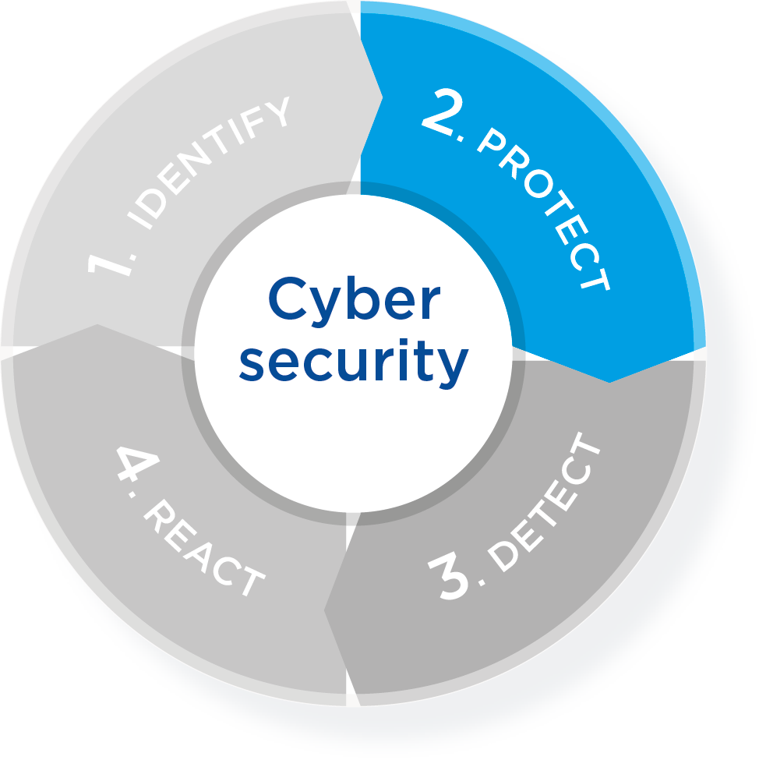
The pillars of cybersecurity
Cybersecurity
Analyze the system and identify the weaknesses
Limit intrusions and impact through effective protection
Detect abnormal and suspicious behavior of the system
Ensure recovery
Notes:
Identifier et protéger les périmètres qui constituent votre système d'automatisme et de supervision
Limiter l’impact d’une intrusion. La bonne politique consiste à poser des barrières, retarder les intrusions
Surveillance de vos installations en mettant en place des dispositifs de détection des intrusions et de surveillance
P.R.A / P.C.A (plans de reprise et plans de continuité d'activité) pour prévoir les conditions de remise en état de marche des composants du système après incident

Slide 18
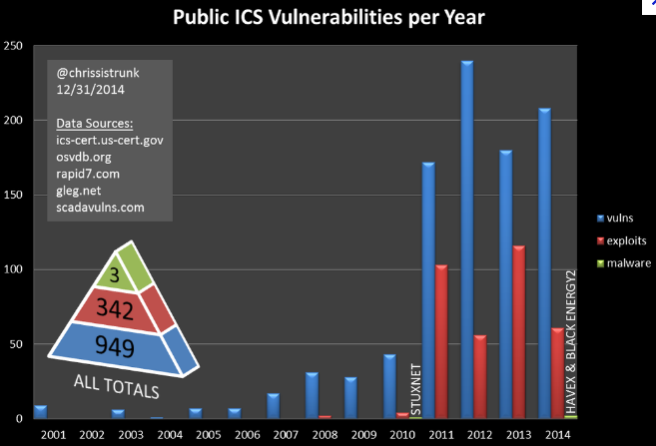
…and real risks
Cybersecurity
Information security weaknesses can lead to major consequences
2010: Stuxnet
Siemens
Modification of PLCs programs to reduce performances of process
Target: Iranian nuclear facility
2011: Worm DUQU
Got system information and keystrokes
2012: FLAME
Gathered sensitive data of Iranian computer systems
2014: Dragon fly
Hundred Europeans utilities companies targeted
2015: WIRED
Physical damage of a steel mill in Germany
…
Misuse, accident, intrusions
Data leakage, intellectual property theft
Personal safety and property security
From breaking a business
To killing people
Up to breaking a nation

Slide 19
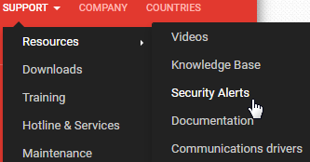
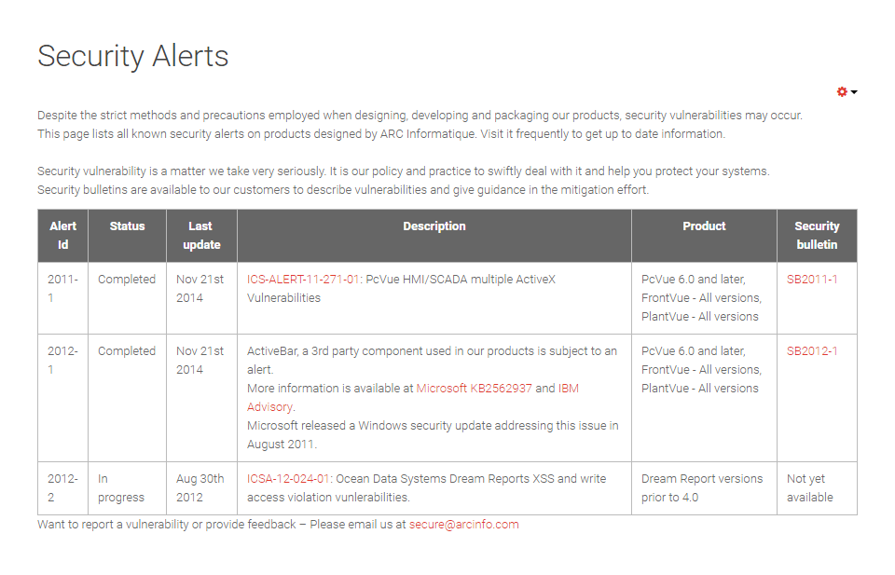
Security policy
Cybersecurity
Threats never end…
Our security policy aims to minimize their impact implementing transparent practices in regard to our customers, authorities and the general public.
Provide our expertise to our customers and partners to help them implement secure solutions,
Ensure active monitoring and tracking notifications about our products,
Coordinate our actions with the CERT network - Computer Emergency Response Teams,
Take advantage of feedback to design safer products,
Communicate seamlessly on known vulnerabilities of our products with security alerts
Notes:
Despite all the efforts made, our products may be subject to vulnerabilities that could endanger the systems in which they are integrated.
In order to minimize the impact of these vulnerabilities, ARC Informatique is implementing transparent practices in regard to its customers, authorities and the general public.
In practice, and beyond our product design phases, we commit to:
1. Provide our expertise to our customers and partners to help them implement secure solutions,
2. Ensure active monitoring and tracking notifications about our products,
3. To coordinate our actions with the CERT network - Computer Emergency Response Teams - and the actors of computer security that adhere to these commitments and CERT recommendations
4. Communicate seamlessly on known vulnerabilities of our products with security alerts - Issues either discovered internally or by third parties,
5. In case of alert, provide safety bulletins to provide information as quickly as possible to our customers to reduce immediate risks,
6. Take advantage of feedback to design safer products.

Slide 20
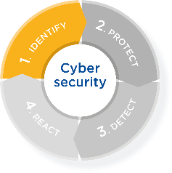
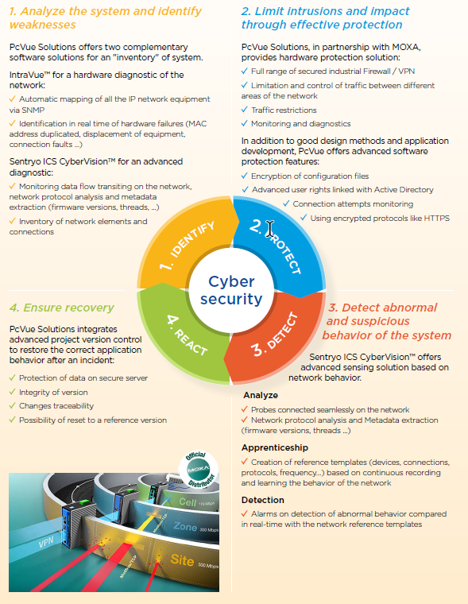
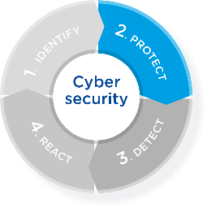
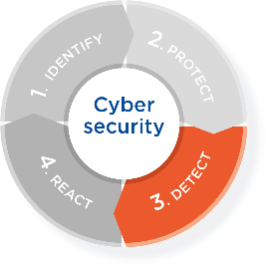
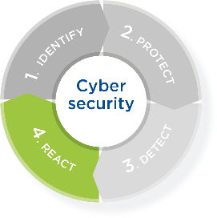
PcVueSolutions cybersecurity offer
Cybersecurity
Identify weaknesses
Monitoring data flow : Sentryo
Protect
Package installation sécurisé (Signature) : PcVue
Secure drivers (SNMP v3) : PcVue
Secure deployment (RDS, Virtualisation) : PcVue
User management (LDAP) : PcVue
Hardware network protection : Moxa
Detect abnormal behavior
Weaknesses detection : Sentryo
Log events: PcVue
React to ensure recovery
Reference status comparison : Sentryo
Cybersecurity alert (SIEM / SOC) : Sentryo
Project centralized version : PcVue

Slide 21
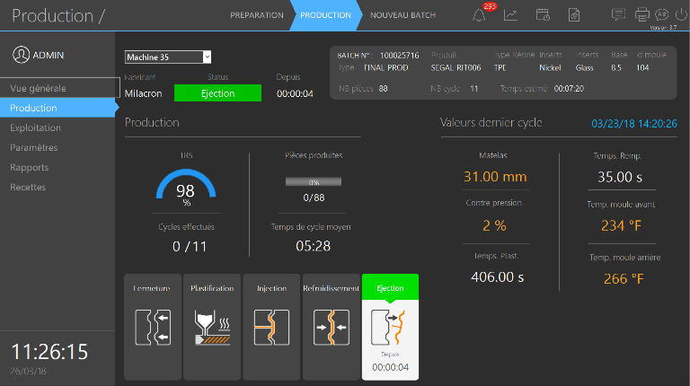
Universal interface
The extension of the operator

Slide 22
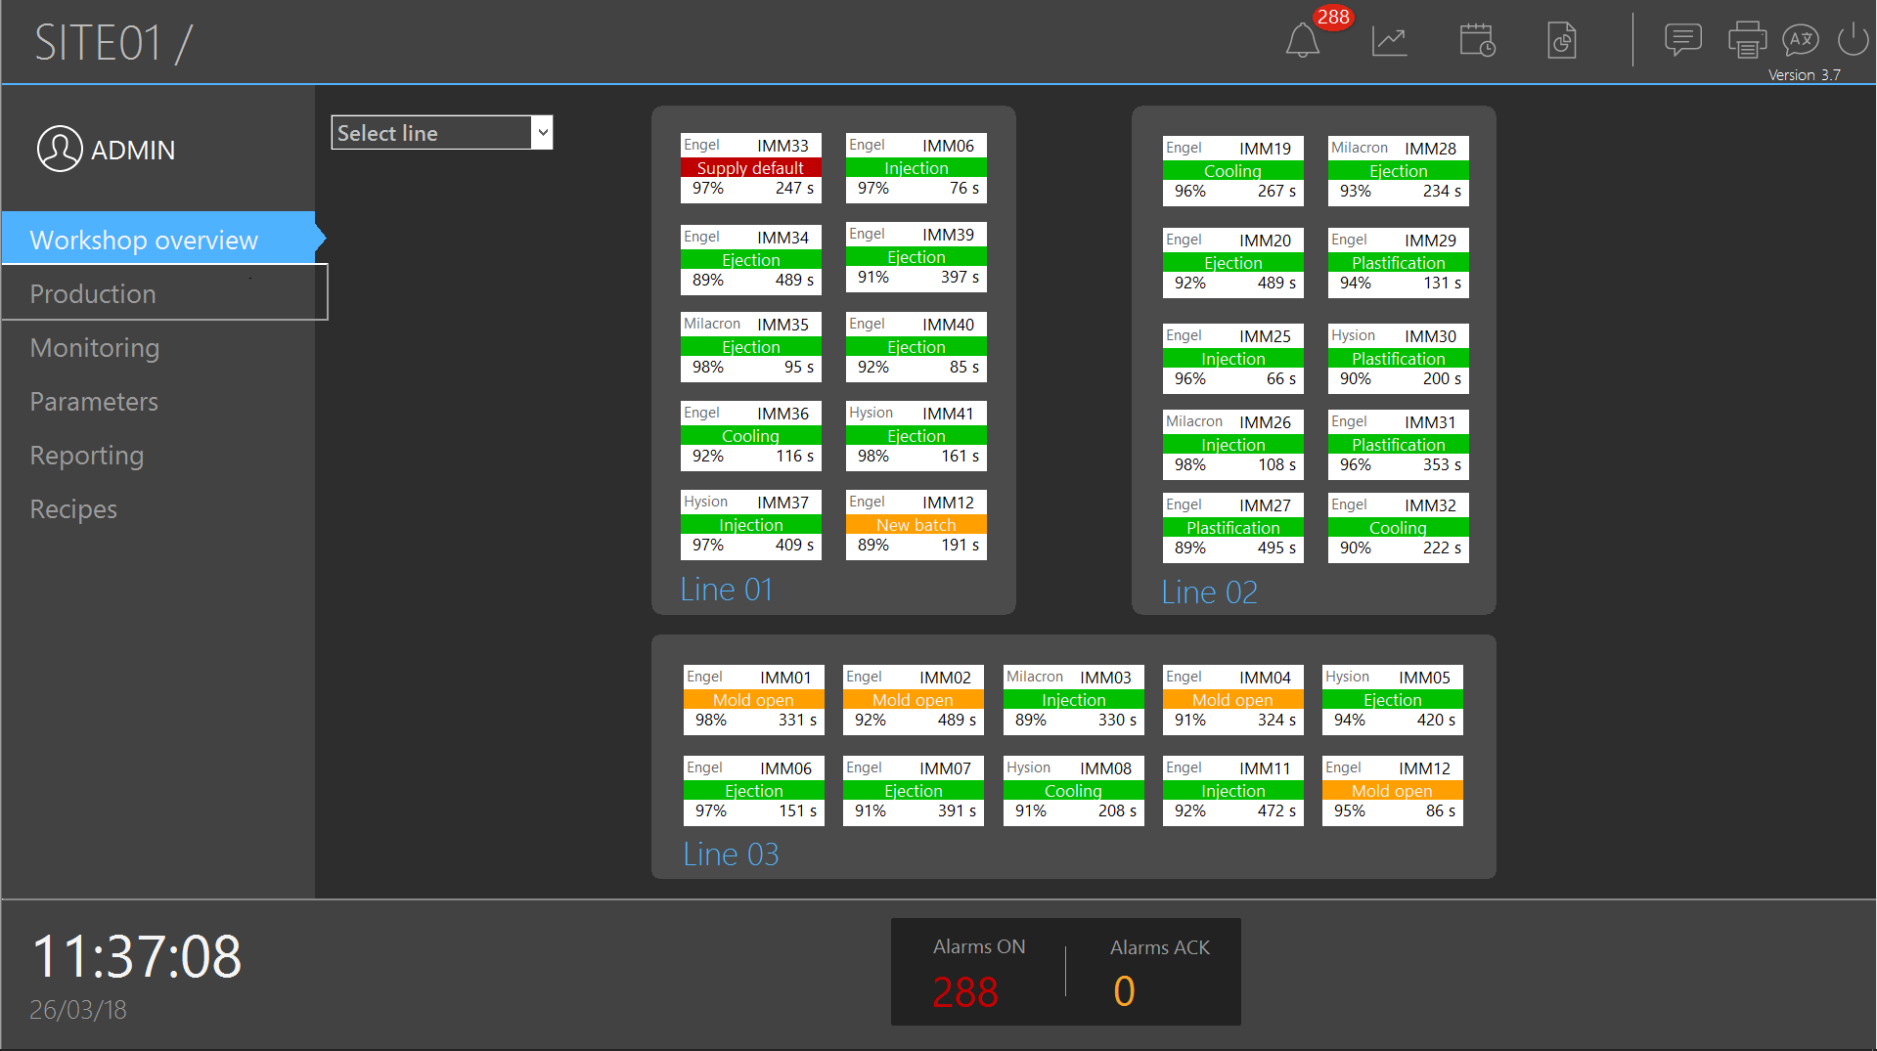
Interface universelle
A machine site at a glance

Slide 23
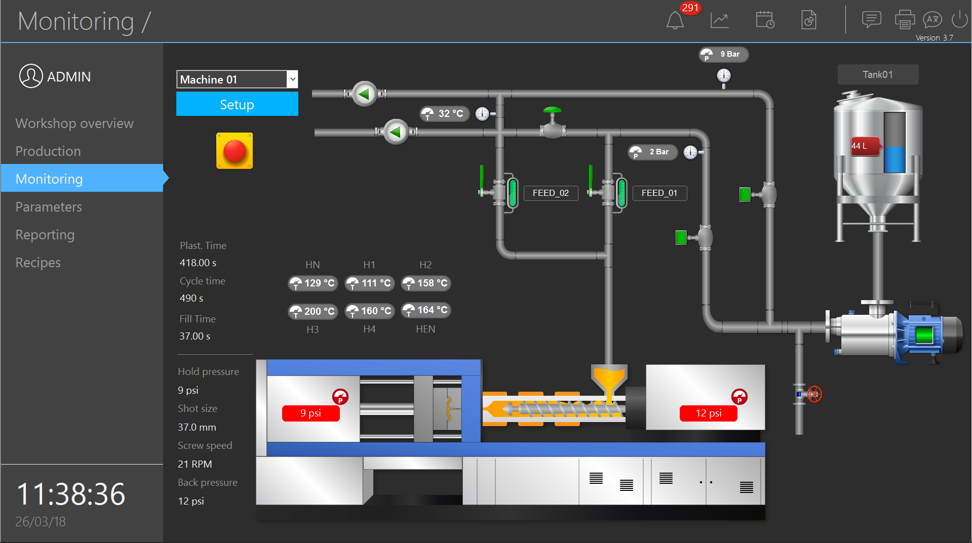
Différents besoins, une seule interface
Monitor and control a industrial process

Slide 24

Différents besoins, une seule interface
Visualize real time production data

Slide 25
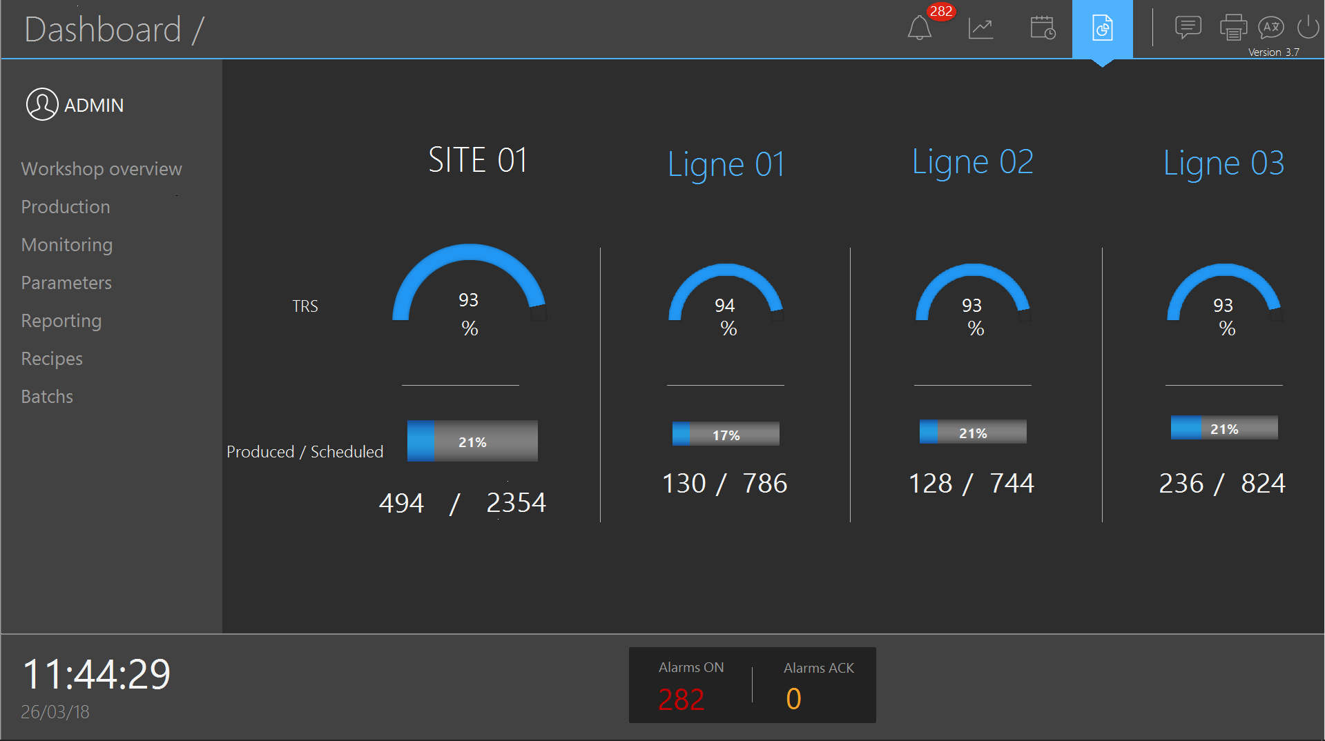
Several needs, an unique interface
Dashboard

Slide 26
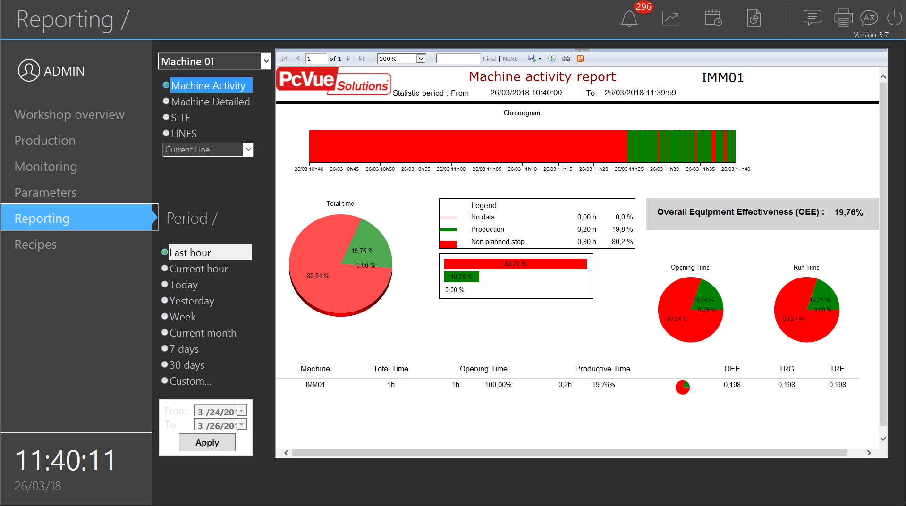
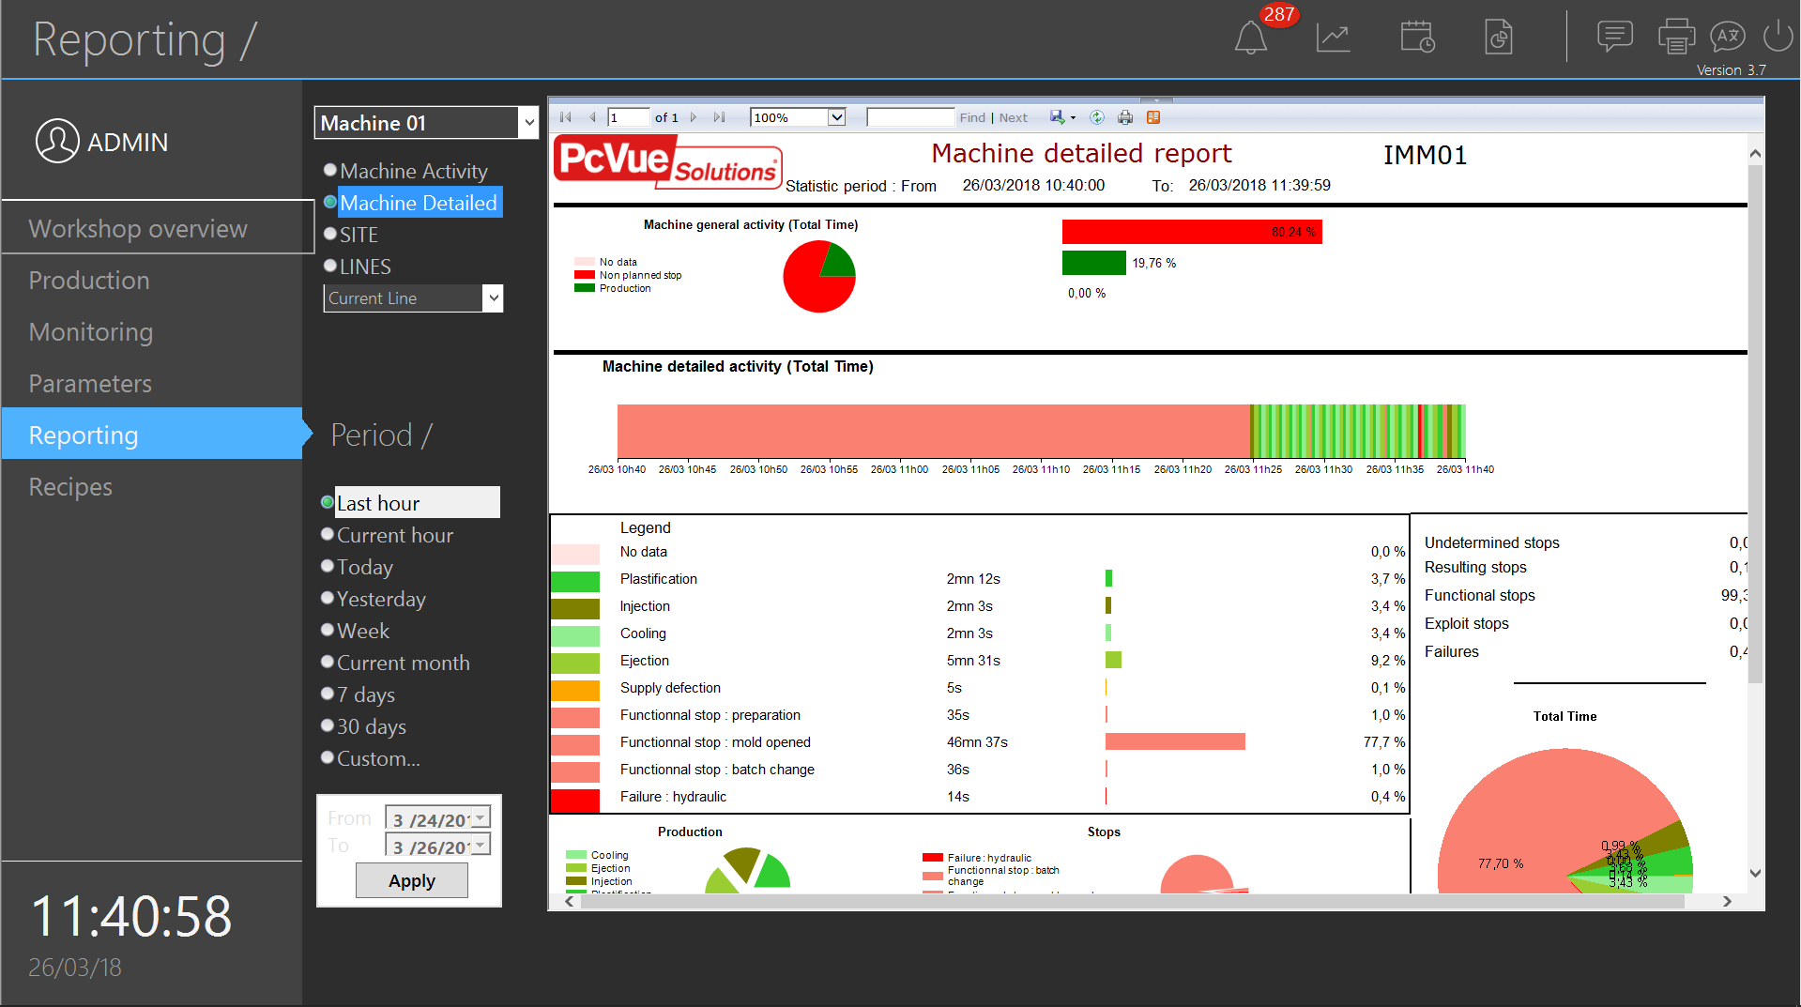
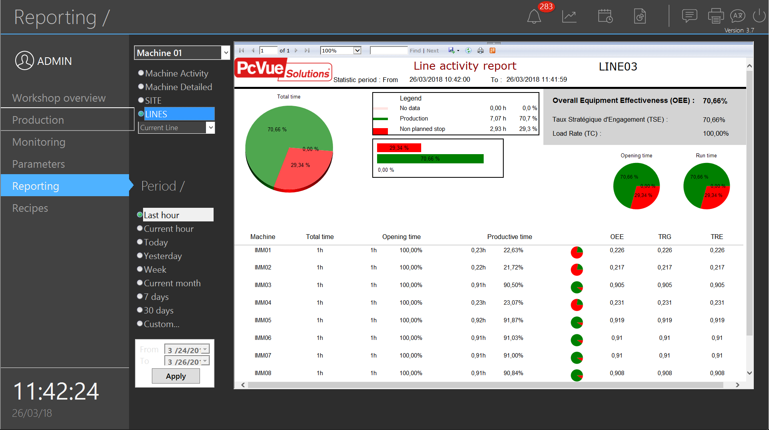
Différents besoins, une seule interface
Visualize the activity reports for a site, a workshop, a machine

Slide 27
Mobile Solutions
The operator always close to the process

Slide 28







Comprehensive Offer
Web & Mobile
Navigation based solution
Notification based solution
Location based solution
HTML5 Client
Context given by user navigation
A Solution for all Mobility Requirements
-
Solutions can be used individually
or
Can be combined together
On-call/on-duty app
Context given by notification
ContextVue
Geo-contextual app* Context given by user’s role and environment
*>12
Icon made by Freepik from www.flaticon.com
Notes:
The offer is built around 3 solutions covering different contexts
Navigation based solution:
Remote monitoring and control of the PcVue project using manual user navigation thru mimics
This could be done either with WebVue as a mobile app or a web client or a remote client (RDS)
Situational awareness based solution:
A solution based on alarm notification for immediate action (acknoledgment, set values, send command,…)
Allows to monitor and control key data of the process
Location based solutions:
A solution to provide the mobile user with pertinent info depending on his location and his role

Slide 29

Technology for Web & mobile
Web & Mobile
The mobile solutions are based on the exclusive EasyMobileTechnology which ensures a fast, easy and secure configuration & deployment :
No gateway, no extra plugin
No installation on client side
Easy settings – no scripts – Wizard only
Open to third-party application
Adapted to any users: end-user, SI, IT
Secure scalable architectures and communication
Easy Diagnostic
Affordable solutions

Slide 30


WebVue
Navigation based solution
Full WEB-based HMI
HTML5 client

Slide 31







WebVue 12
Navigation based
Solution
Full built-in HTML5-based client
Pure HTML
Better graphics rendering
Better user experience
IT friendly - secured
Cross-browser compatibility
Scalable & open
Mobile friendly
Less resource intensive
Notes:
Better user experience
More responsive because event-driven/Fast and flowy navigation
Multi-tab
Cross-browser support
User context & session variables: True multi-user capacity, even for internal variables
Open API: Can integrate symbols and mimics in its own apps or web-portals

Slide 32
WebVue 12 - Benefits
Navigation based solution
UX for better efficiency : seamless and smooth interfaces
Easy to deploy, zero installation, no extra development
IT friendly solutions
Secure architectures and communication
Deployment console
Web client can be embedded in third party apps or web-portals
Notes:
UX for better efficiency : flowy and smooth interfaces
Easy to deploy, Zero installation
No extra development
IT friendly solutions : secure architectures, secure communication

Slide 33
WebVue 12
Navigation based solution
Benefits for the end user
Zero installation, zero configuration
Better performance, better responsiveness
Ability to monitor mimics on any device with a web browser
Ability to monitor multiple mimics concurrently in multiple web browser tabs

Slide 34
WebVue 12
Navigation based solution
Benefits for the IT department
Easy to deploy
No browser plugin or runtime components required
Improved security thanks to sandboxing in web browser environment
Allows secure architectures by installing web server components in a DMZ
Secure communication - HTTPS only
Notes:
Web Server components can be installed independently from PcVue
Web Deployment Console – The Sysadmin tool for deploying the PcVue Web Server components

Slide 35
WebVue 12
Navigation based solution
Benefits for the SI
Full web-based HMI
Transparent license model
Open API: Can integrate symbols and mimics in its own apps or web-portals
User context: True multi-user capacity, even for internal variables
Cross-platform: runs on almost every device regardless of the operating system
A new RESTFul/Json Web Services Toolkit

Slide 36
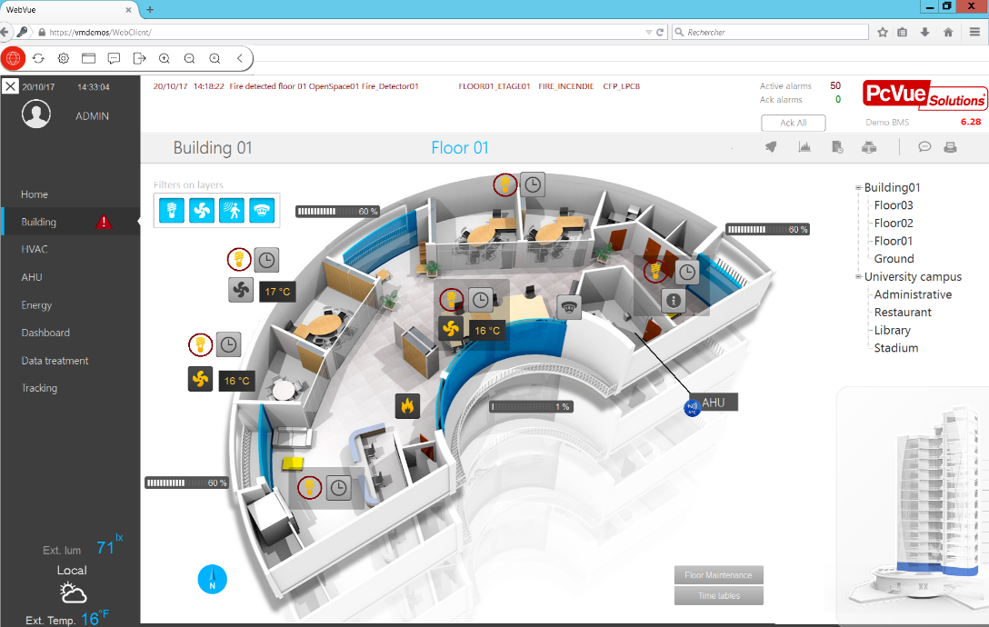


WebVue 12 - Screenshots
Navigation based solution

Slide 37
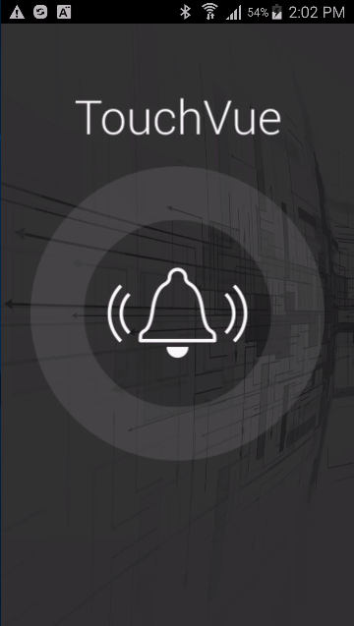
TouchVue
Solution
Notifications
The mobile application for immediate action

Slide 38
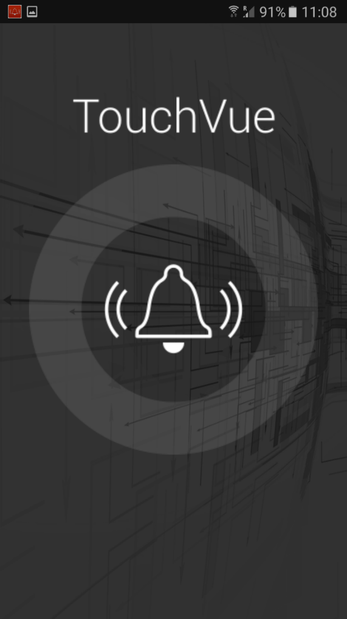
TouchVue 12 – Key features
Solution
Notifications
On-call/on-duty mobile app for PcVue
Access the data from several sites
Real time information and notifications (Alarms, values, trends) for immediate action (acknowledgment or control values)
Archived data (events logs, historical trends)
Contextual mimic display
Data filter depending on user profiles
Watchlist for favorite variables to watch

Slide 39
TouchVue – Who/what
Solution
Notifications
For who
Maintenance team on duty on site/off site
Occupants
Managers
For what
Quick and fast access
When mimic give too much information
When navigate thru a mimic become a waste of time
Quick respond to alarms and events for immediate action
Check setpoint or trends
Control devices

Slide 40
TouchVue 12 - benefits
Solution
Notifications
The power of the PcVue contextual approach in your pocket
Fill the gap where remote access and light clients are not enough
Help both sub-contractors and end-users in reducing costs
Give managers an eye on their site
Cost effective solution
Designed by Kreativkolors / Freepik

Slide 41



The use case: On-duty teams
Solution
Notifications
Using alerting systems is good
Share maintenance team costs over multiple sites
Actions taken with very few delays
Established in maintenance contracts for years
…But not enough…
Sound decisions requires more than a SMS
Detailed status of the process on site ?
Can/should it be fixed by the team on-site ?
And can save a lot of money
Your best friend is a smart phone
No need to
Call the site to get more information
Find a computer to connect to the site
Move from your sofa before you make up your mind
Go on site if not necessary

Slide 42
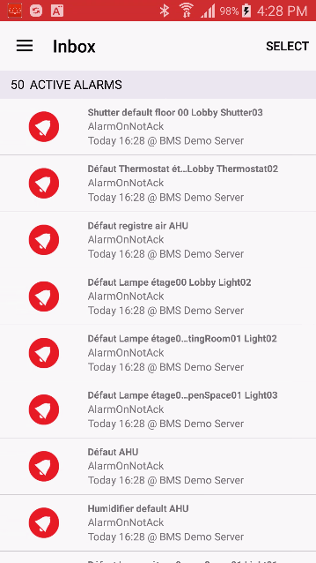
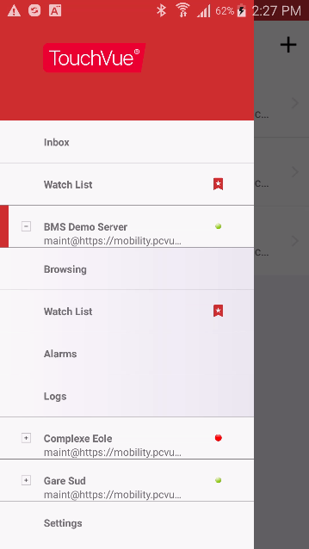
TouchVue 12 – At a glance
Solution
Notifications
Notifications
Notifications logs
List of variables to follow
Variables access
Multi site connexion
Real time alarms list
Recorded event logs

Slide 43
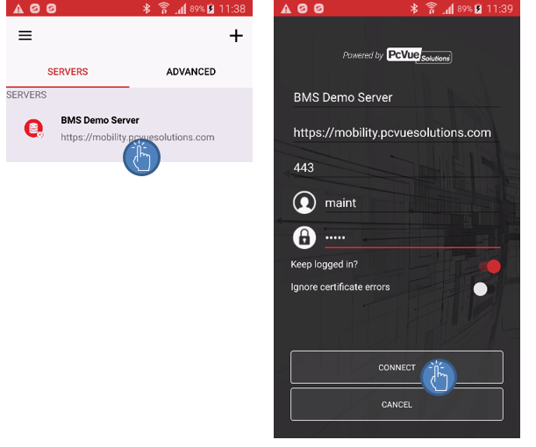
TouchVue 12 – Connection
Solution
Notifications
Server
Server access
Credentials

Slide 44
TouchVue 12 - Alarms
Solution
Notifications
When alarm goes off TouchVue allows :
To get relevant information
Access alarm detail
Control process
To get the context
Check setpoint values
Check trends
Checks alarms and events logs
To remotely take action
Acknowledge/mask alarms
Change a setpoint
Control a device
Take the right decision on site
Avoid a trip on site…

Slide 45
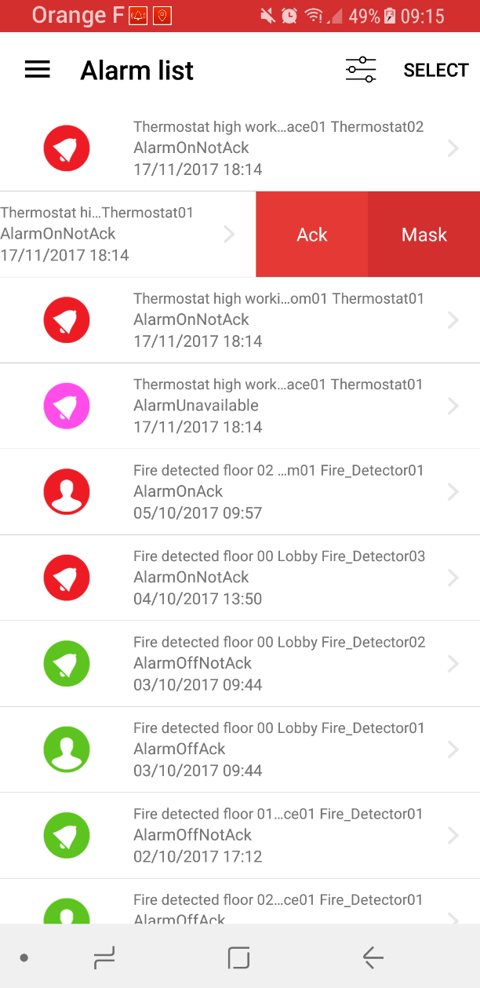
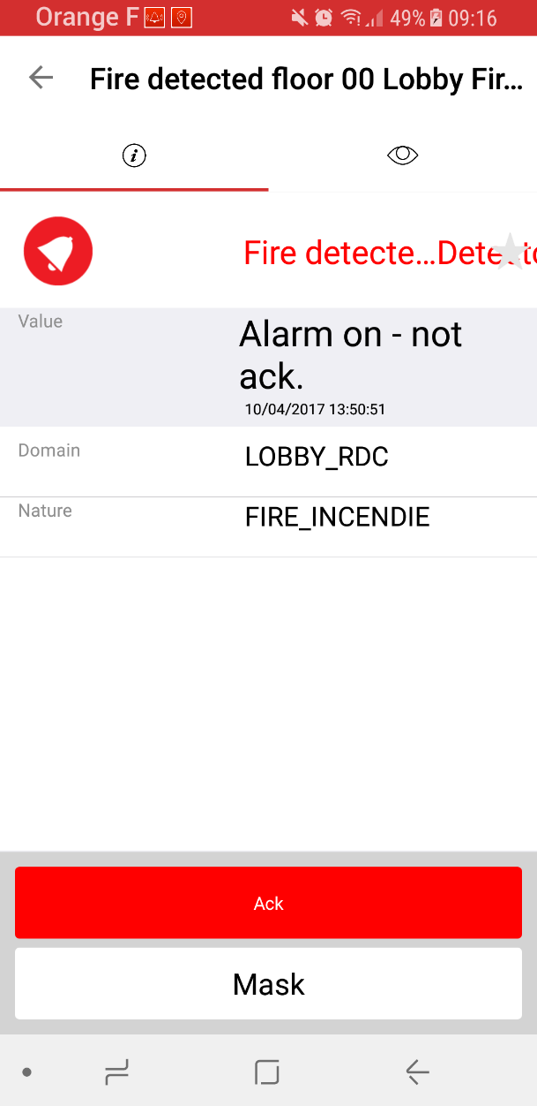
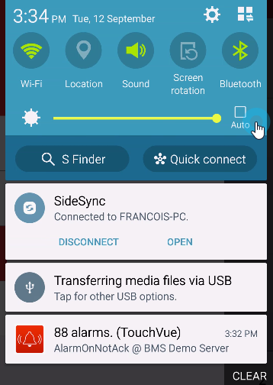
TouchVue 12 – Alarms
Solution
Notifications
Status &
name
Aknowledgment or mask
Selection
Status
Attributs
Notified alarms
Real Time list
Detail

Slide 46
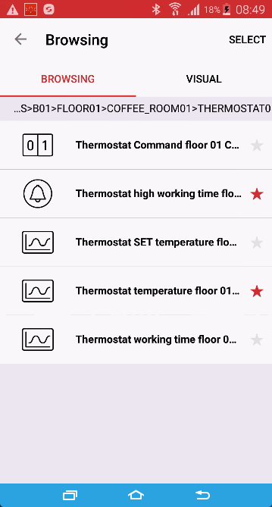
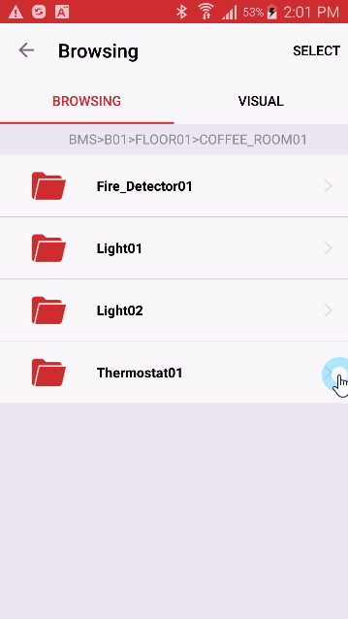
TouchVue 12– Real time data access
Solution
Notifications
Access real time information of your process
Monitor, control
Favorite variable
Variable tree

Slide 47
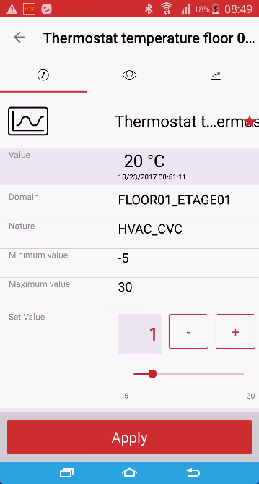
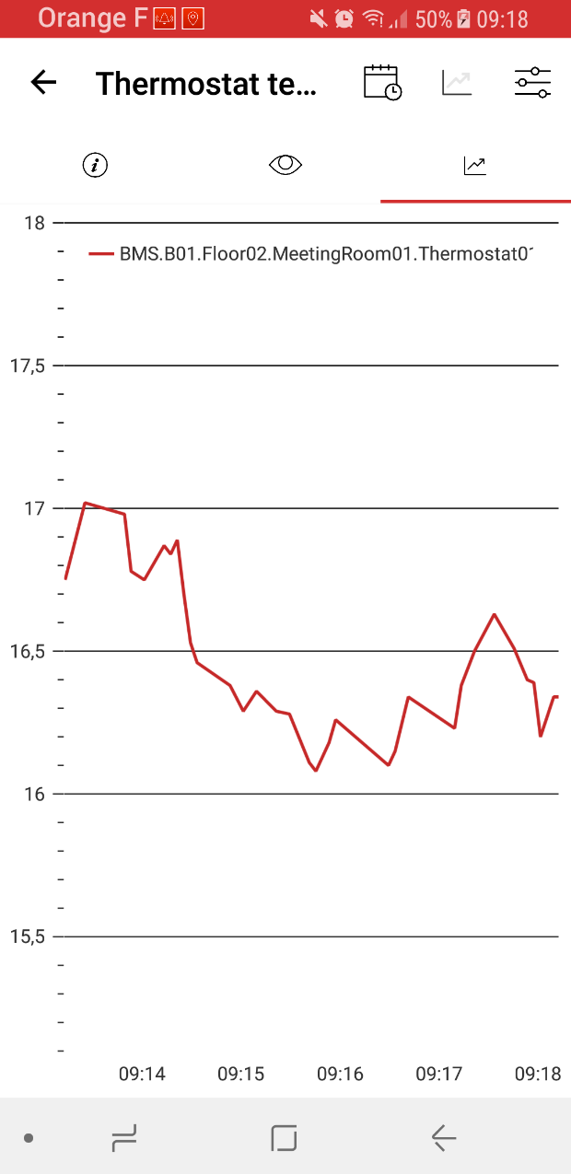
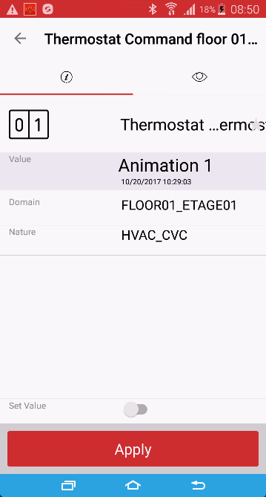
TouchVue 12 – Monitor & control
Solution
Notifications
Analog value
Bit

Slide 48

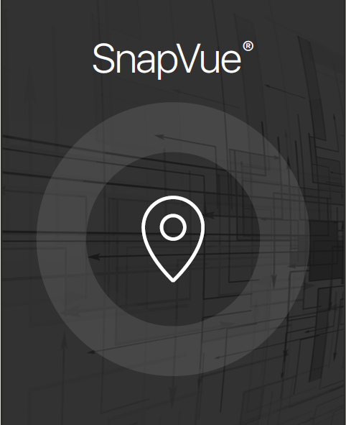
SnapVue
Location based
Solution
The contextual mobile app

Slide 49

Contextual mobility
Location based
Solution
The extension of your process
Exchange and visualize relevant information
on a mobile device in the context of location/role
Take advantages of geolocation technologies
Automatically push information to the mobile user
Allows the mobile user to interact in an intuitive way
- Without the need to navigate through menus
The right information
At the right place
At the right time
To the right people
Mobile app + Geolocation + Services

Slide 50
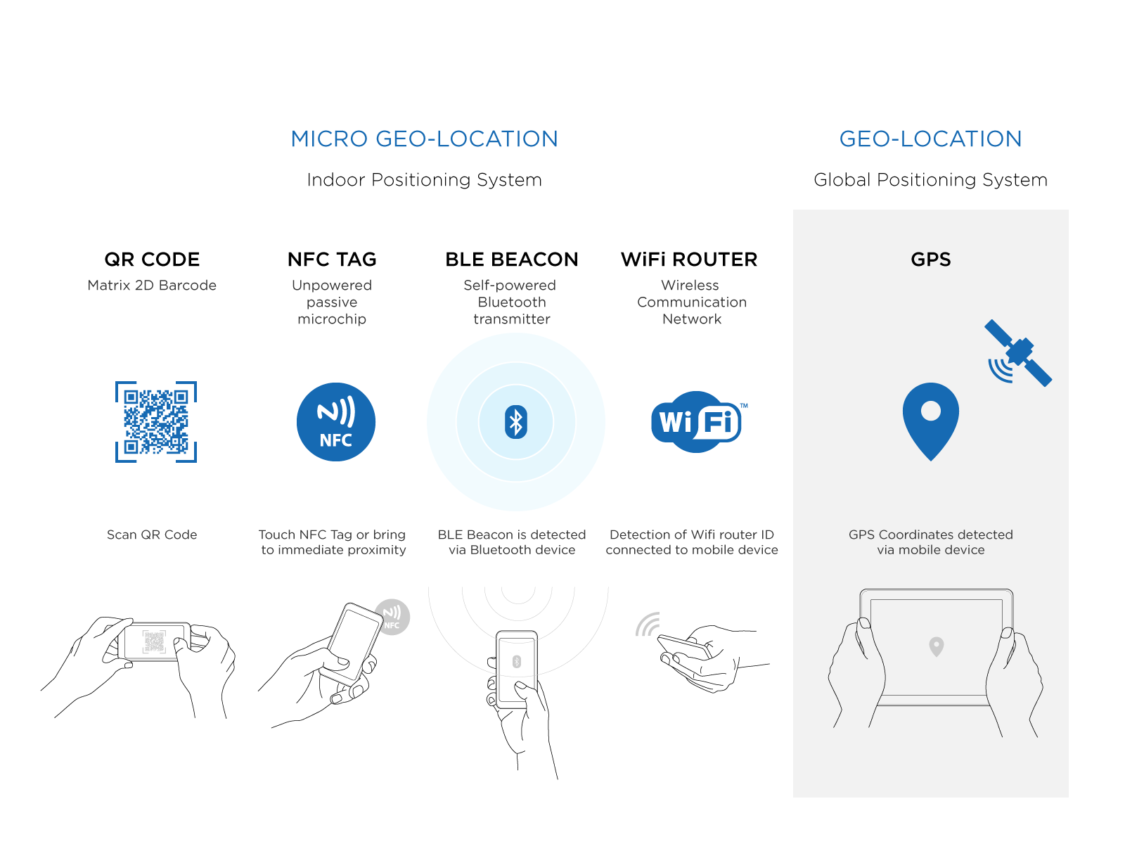
Location devices
Location based
Solution

Slide 51
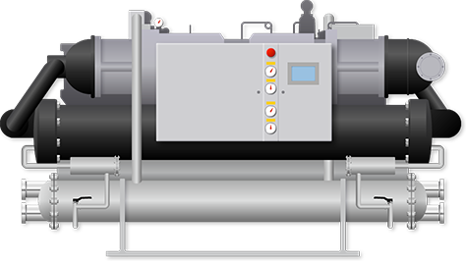



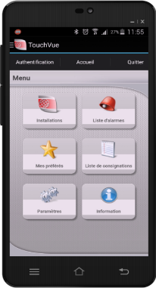
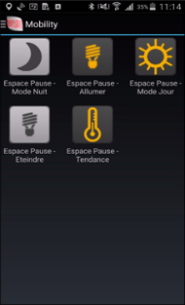
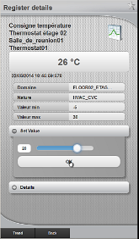
Maintenance operations
Location based
Solution
Scenario
Benefits
A Maintenance staff is performing maintenance task on an equipment.
They are facing a machine or equipment that has no HMI or operator Interface.
They scan the QR code or touch the NFC tag to visualize status and parameters.
They then set the equipment to maintenance mode masking alarms, then enter their maintenance actions & reports.
They can consult Manuals or Equipment datasheets as needed.
Provides a mobile interface to verify status live of connected equipment.
Improves safety as maintenance staff has full live information and data sheet/manual available
Can tune parameters according to overall system and visual reality on the spot
Intervention summary done on the spot and immediately recorded on central system
Automatically provides the correct information depending on where the maintenance staff is
All Industries, Infrastructures and BMS applications.

Slide 52
?
?
Questions… …Answers
!
!
?
?
!
!
!
?
?
?
!
?
!
Let’s talk !

Slide 53
Thank you for your attention
#
Name
Email
Phone
Keep in touch !

